Slide 1



Westmark Auto Loans
Cannon Bray
Avery Robbins
Jashon Newlun
Mallory Jones
Cristobal Sanhueza
J. Hathaway

Slide 2




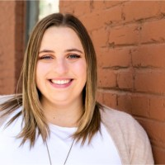
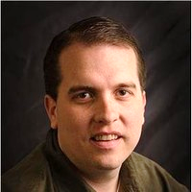
Aspiring Predictive Modeler and Actuary. This is his final semester at BYUI. Jashon grew up in Washington State and has lived in Texas, Romania, and Moldova.
Aspiring Data Scientist and incoming summer intern at BYU Pathway Worldwide. Avery loves programming in R and competing in Spikeball tournaments.
Aspiring Data Scientist (specialty: social impact). Cannon plans to graduate in the spring of this year. He hopes to return to DHS in Oregon, where he grew up.
Cristobal is project manager and plans on going to grad school for statistics at UCI.
Aspiring Data Scientist and Sociologist. Mallory graduates this semester and has accepted a position with an insurance company in her home state of Utah.
Faculty Mentor and head of the Data Science department at BYUI.

Slide 3
Project Overview
Who will purchase a product beyond their auto loan? – Machine Learning
What product will influence their conversion? – Likeliness to convert based on time
Research – How do our findings compare to the industry at large?

Slide 4
Terminology
Dealer Loan Only: a member that obtains an auto loan from a dealership. Includes opening a primary savings account
Full Membership: A member that has other Westmark products such as a checking account, credit card, CD, etc.
Convert to full membership: Dealer loan member that obtains more products from Westmark Credit Union

Slide 5
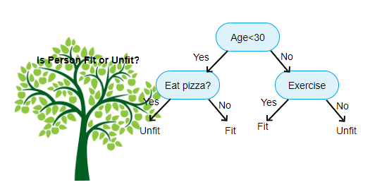
Machine Learning - Overview
Using past data, analysts can use machine learning to predict what will happen in the future.
In our case we use those who did switch and did not switch in the past, to predict who is more likely to switch in the future.
The algorithm learns the attributes of both groups and classifies a new dealer loan customer according to their attributes.
Common Algorithms : Decision trees, Naïve Bayes, Neural Networks, Boosted Trees.
Notes:
https://towardsdatascience.com/decision-trees-in-machine-learning-641b9c4e8052 – Decision Tree
https://towardsdatascience.com/first-neural-network-for-beginners-explained-with-code-4cfd37e06eaf - Neural Network
https://towardsdatascience.com/machine-learning-for-beginners-d247a9420dab - Overview

Slide 6
Machine learning - overview
Past Data:
Data about each person
Did they convert or not?
Learning
Tuning
Final Model
New Data:
Data about each person
Did they convert or not?
Final Model
Predictions

Slide 7
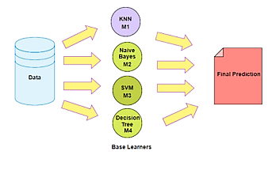
MACHINE LEARNING – OUR MODEL
Our model is comprised of about ten different algorithms. They were combined in a process called “ensembling”.
Our most useful model, is a boosted tree model. This is much like a decision tree, where new trees are created to improve on the original model. Then all the trees get to cast a vote. The votes are tallied and the majority wins.

Slide 8

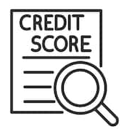

Research
Contact within the first
90 days¹
3-4 times in 90- day window
“Indirect auto lending can generate massive financial growth, particularly if you dip into members with lower credit scores”²
Members living within a 3-mile radius of the branch are the best candidates for conversion¹
Notes:
https://www.televox.com/downloads/indirect_member_wp.pdf
https://www.openlending.com/post/how-to-deepen-relationships-with-indirect-members

Slide 9


Research
The dealer loan customer is focused entirely on the loan and the car⁴
Most Credit Unions have success converting members with a line of credit, credit cards, or auto refinancing³
Notes:
3. https://allegroloan.com/best-practices-for-converting-indirect-members/
4. https://www.ezcarcare.com/indirect-lending-white-paper.html

Slide 10
Research Takeaways
Contact member within 90 days of obtaining the loan
Reach out 3-4 times during that period by personalized mail, email or phone call
Welcome them to Westmark Credit Union
Contact members that live nearby the branches
Personalization – sense of exclusivity
“With your new loan, you’re eligible for…”

Slide 11
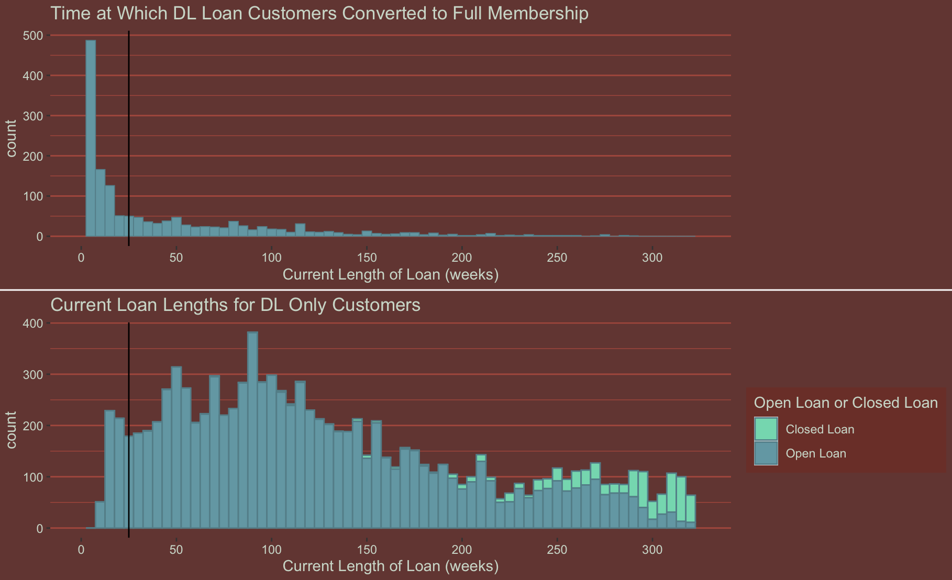
Where we are at now

Slide 12
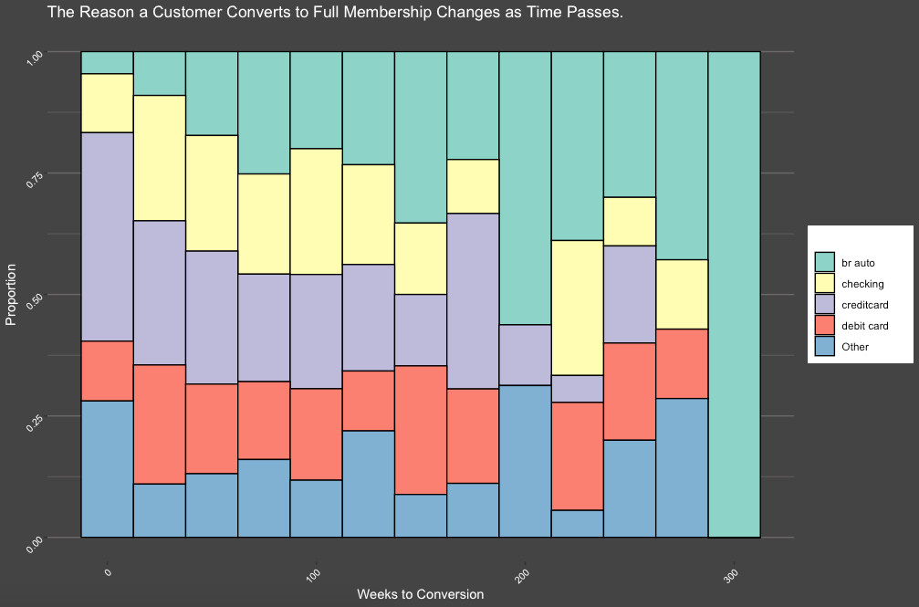
The Reason for conversion changes over time
Early in a customer’s loan, they are more likely to convert because of a credit card/debit card. However as time passes, they are more likely to become a full member because of a second direct auto loan.

Slide 13
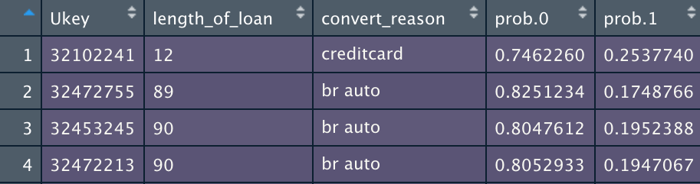
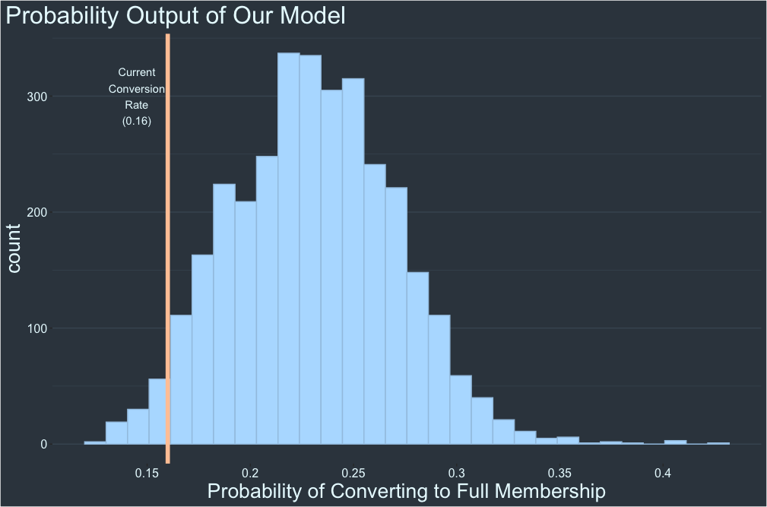
Example output
length_of_loan: Months the customer has had their loan open.
convert_reason: If they convert to full membership, which product they are most likely to switch because of.
Prob.0: Probability they will not convert to full membership.
Prob.1: Probability they will convert to full membership.

Slide 14
Examples
APR: 3.99%
Vehicle Value: $25,527
Term: 36 months
Credit Score: 823
Model
0.13 Probability of converting to full membership

Slide 15
Examples
APR: 5.25%
Vehicle Value: $29,975
Term: 84 months
Credit Score: 756
Model
1.5 times as likely to convert to full membership

Slide 16
Examples
APR: 6.99%
Vehicle Value: $16,950
Term: 78 months
Credit Score: 461
Model
2.5 times as likely to convert to full membership

Slide 17
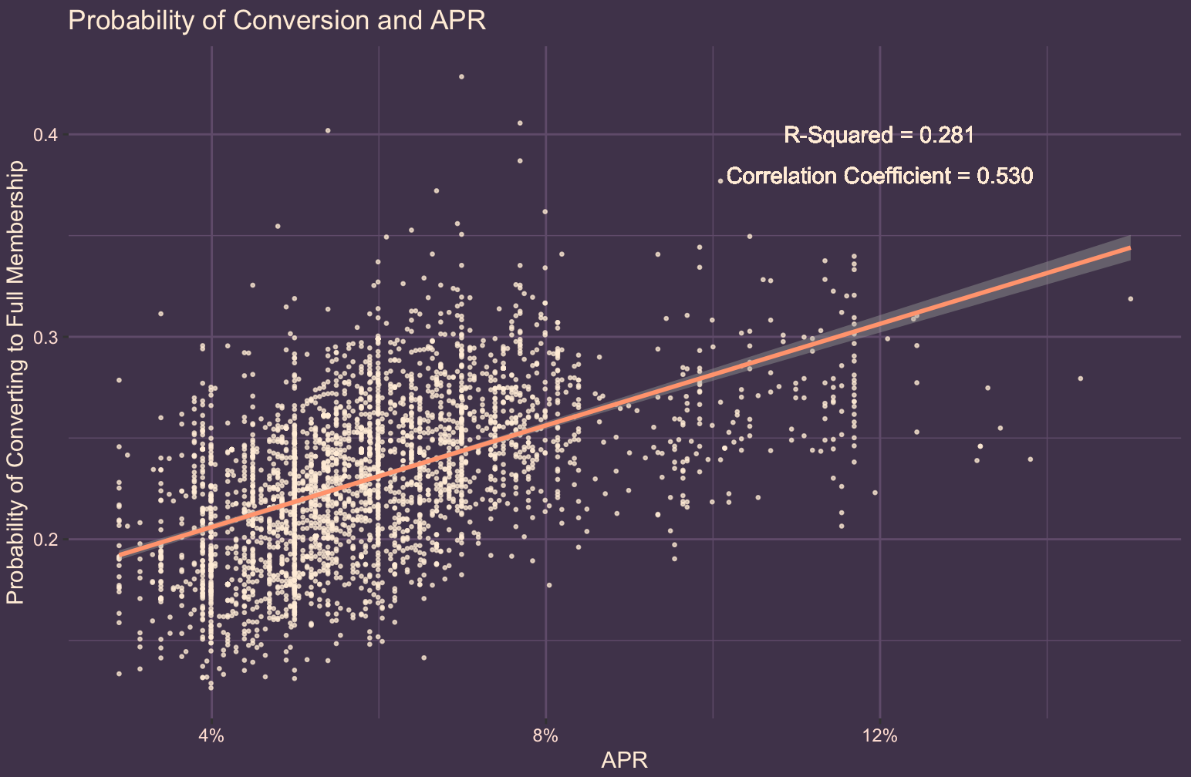
Comparing Our model’s probability prediction with the data
The higher the APR, the more likely a person is to convert.

Slide 18
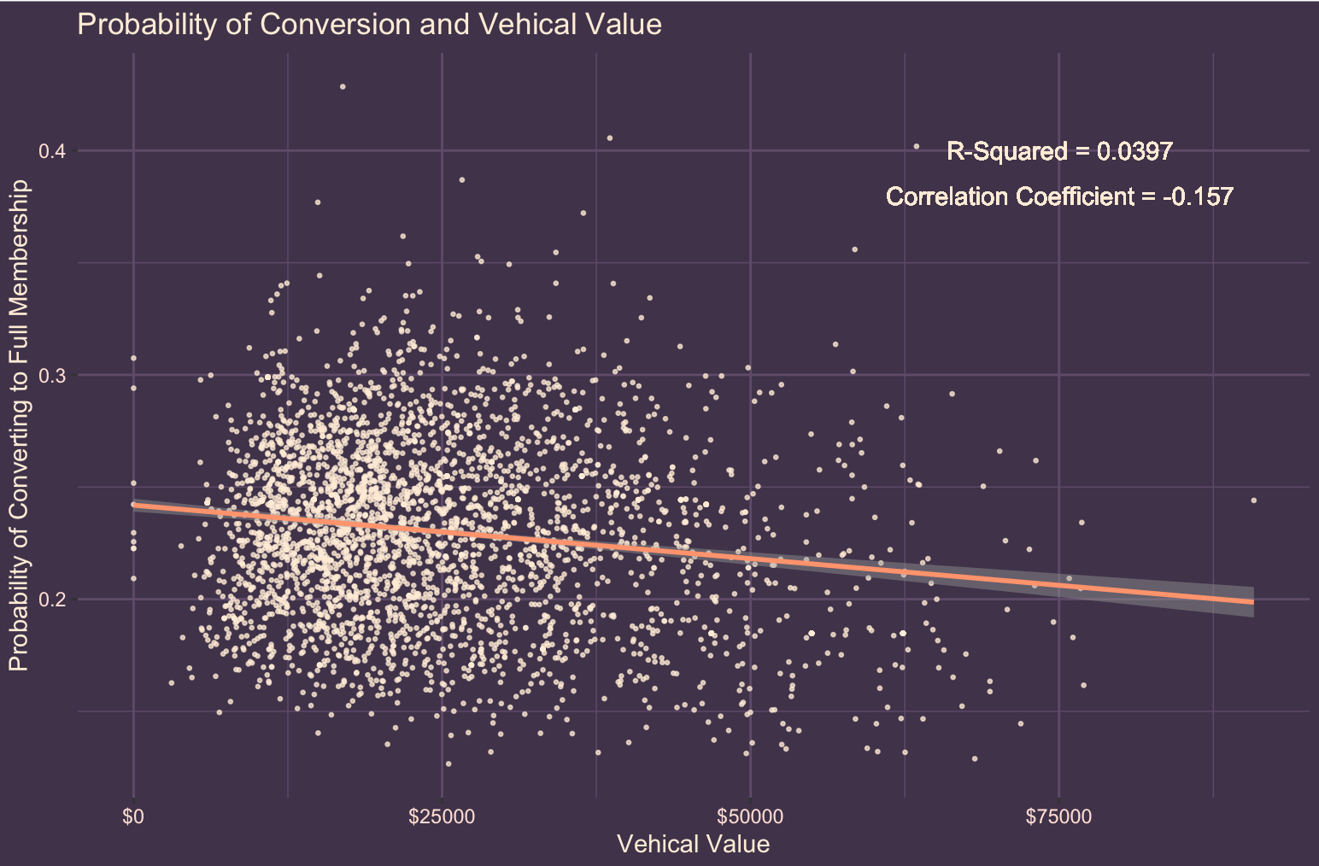
Comparing our model’s probability prediction with the data
The higher the vehicle value, the less likely a person is to convert.

Slide 19
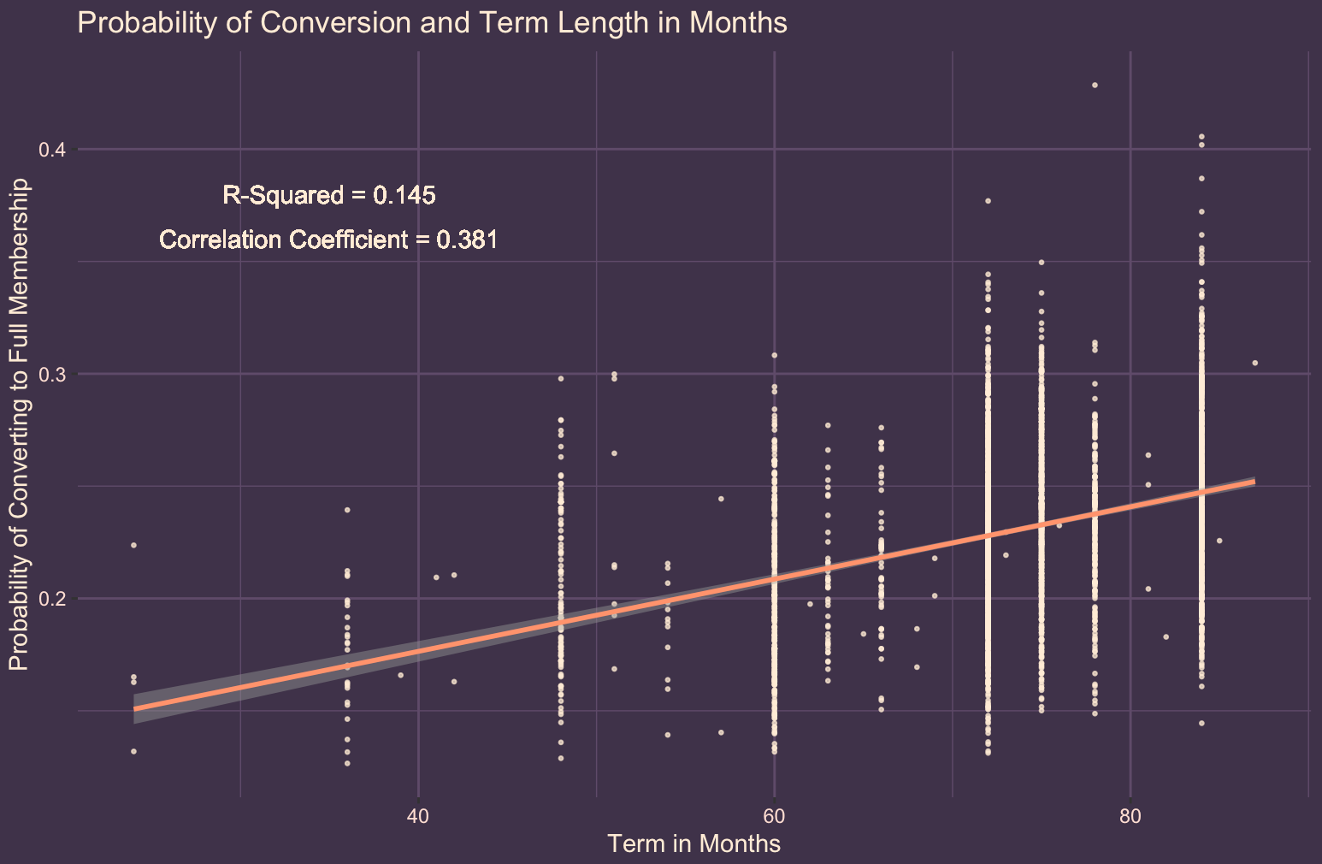
Comparing our model’s probability prediction with the data
The longer the loan, the more likely a person is to convert.

Slide 20
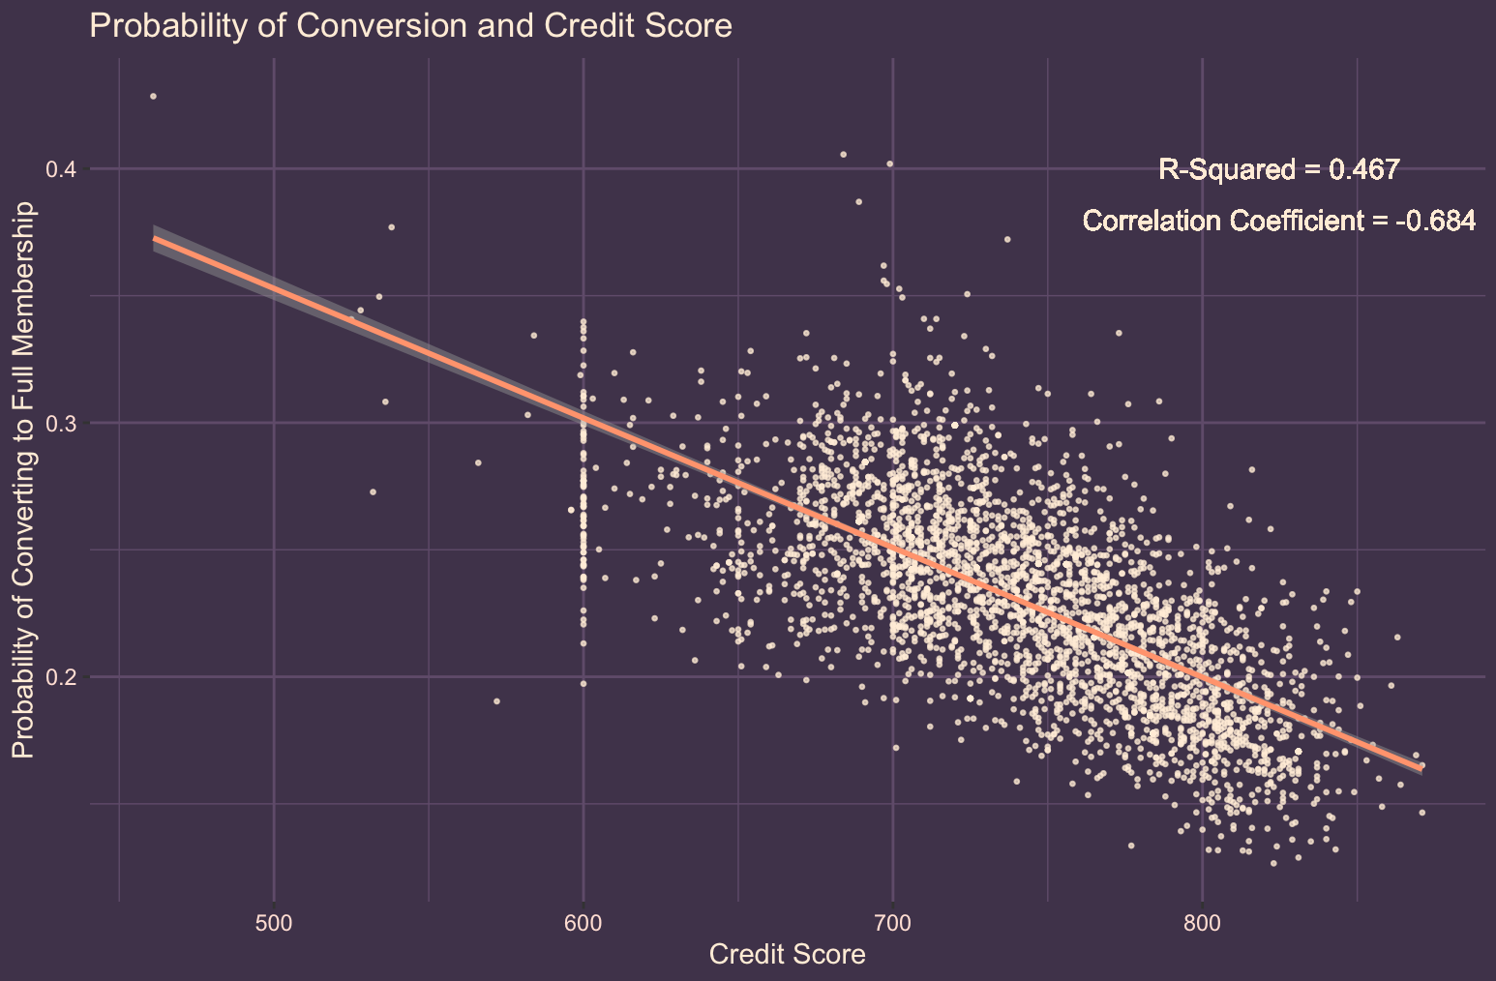
Comparing our Model’s probability prediction with the data
The higher the credit score the less likely a person is to convert.

Slide 21
Take-Aways
We can predict with much greater accuracy which new loan customers will convert to other products (.43 max).
Our predictions are made possible by a complex machine learning tool that takes a person’s information as inputs and outputs the probability that they will convert.
Though the model needs a person’s full set of information as an input, several variables seem to have more impact than others (credit score, vehicle value, APR, and loan term).
Several marketing suggestions paired with these predictions should significantly increase the pull associated with targeted marketing for those with auto loans.
People tend to convert earlier in their loan, if they intend to convert.

Slide 22
Thank You!

Slide 23
Github Repository
https://github.com/BYUIDSS/westmark_credit_WI20

